Slide 1
Project Team - Blue
EDA Phase 2 - Training and Validation
Monisha Vellore Dayananda, Saloni Bhaiya,
Sejal Arora, & Jolie Breitbach

Slide 2




Agenda
Goal
Selected Models
Modeling 1
Modeling 2
Modeling 3
Modeling 4
Conclusion

Slide 3



Goal
The goal in this phase of the project is to choose a final model that can classify records as Attrited or Existing Customers with the required accuracy at least 95%, with precision at least 95% and recall at least 90%

Slide 4


Selected Models
Monisha Vellore Dayananda
-Naive Bayes
Saloni Bhaiya
-Deep Learning
Sejal Arora
- Decision Tree
Jolie Breitbach
- Logistic Regression

Slide 5


Deep Learning Modelling:
Saloni Bhaiya

Slide 6
Deep Learning
Saloni Bhaiya
Deep Learning is a subset of ML, which is essentially a neural network with three or more layers. These neural networks attempts to simulate the behaviour of human brain - matching its ability - allowing it to learn from large amount of data sets.
Deep Learning is Machine Learning Technique that teaches computer to do what comes naturally to humans: learn by example. Deep Learning is a key technology behind driverless cars, enabling them to recognized a stop sign or to distinguished a pedestrian from a lamppost.

Slide 7
Selected Attributes:
Saloni Bhaiya
Avg Utilization ratio
Dependant count
Months inactive 12 months
Months of book
Total amount change Q1 Q4
Total relationship count
Total revolving balance
Total transaction amount
Total Transaction count
Credit Limit

Slide 8
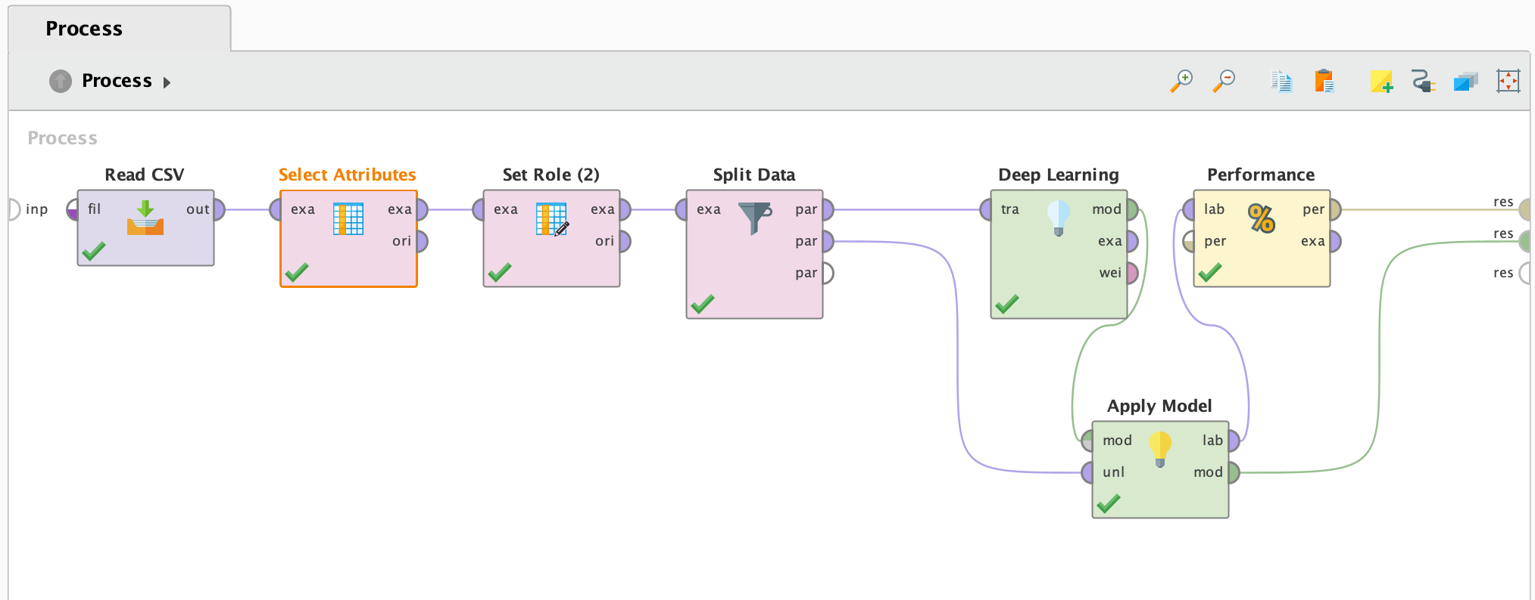
Process for Training and Testing:
Saloni Bhaiya

Slide 9
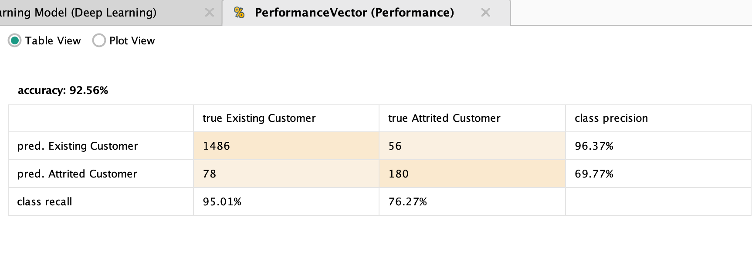
Accuracy, Precision and Recall for Training and Testing:
Saloni Bhaiya

Slide 10
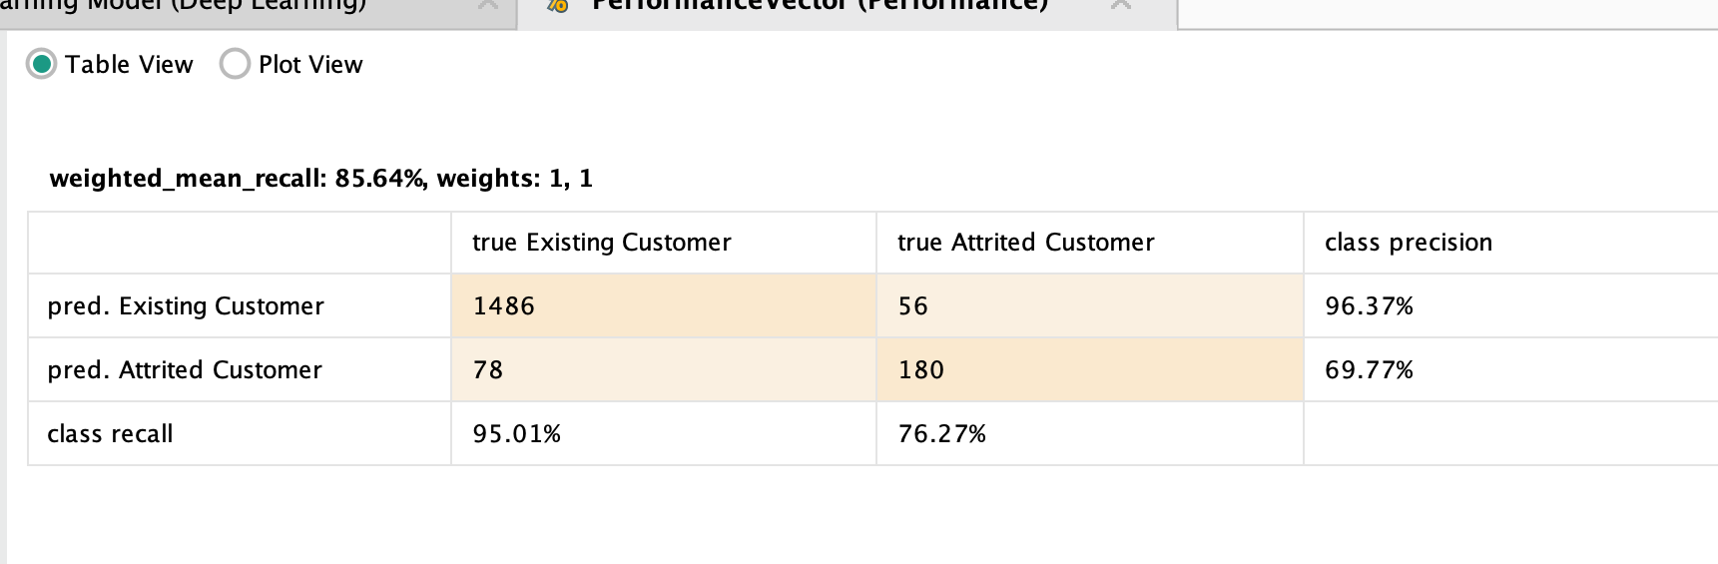
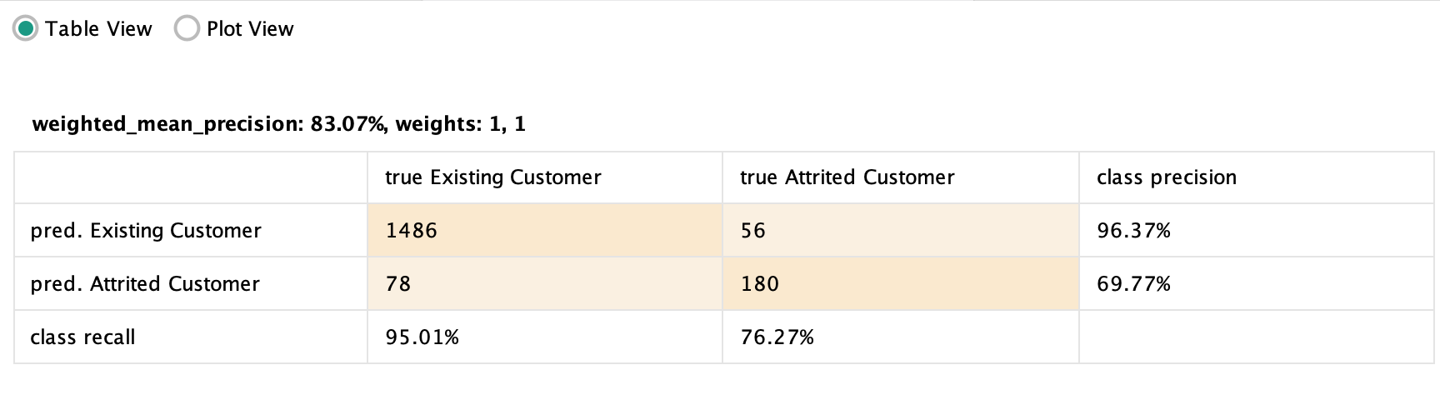
Saloni Bhaiya

Slide 11
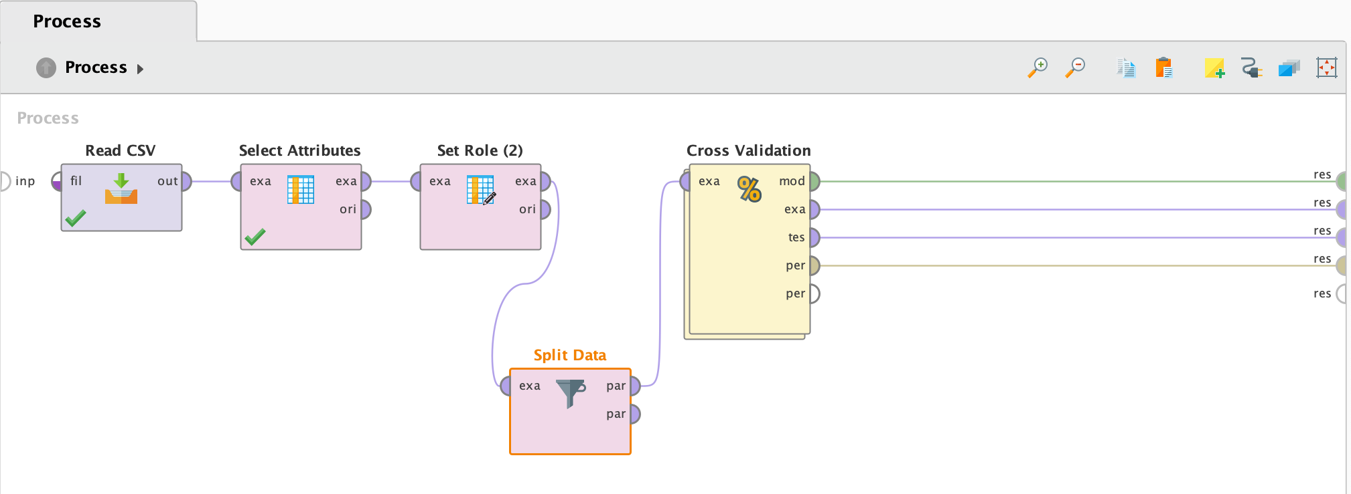
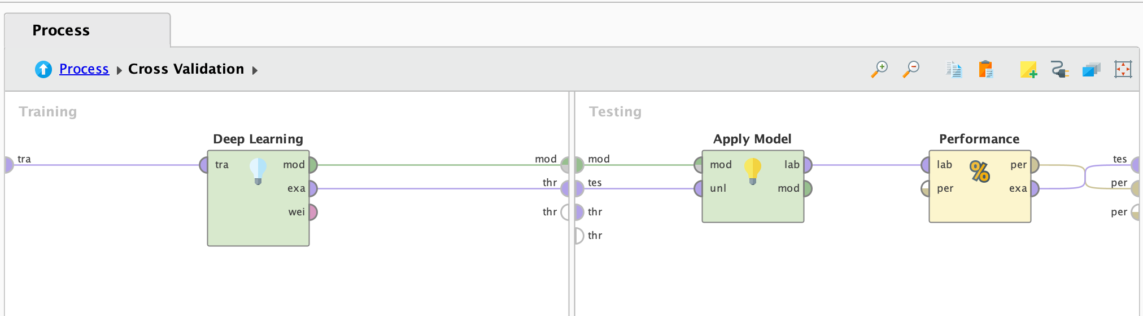
Process for Cross Validation:
Saloni Bhaiya

Slide 12
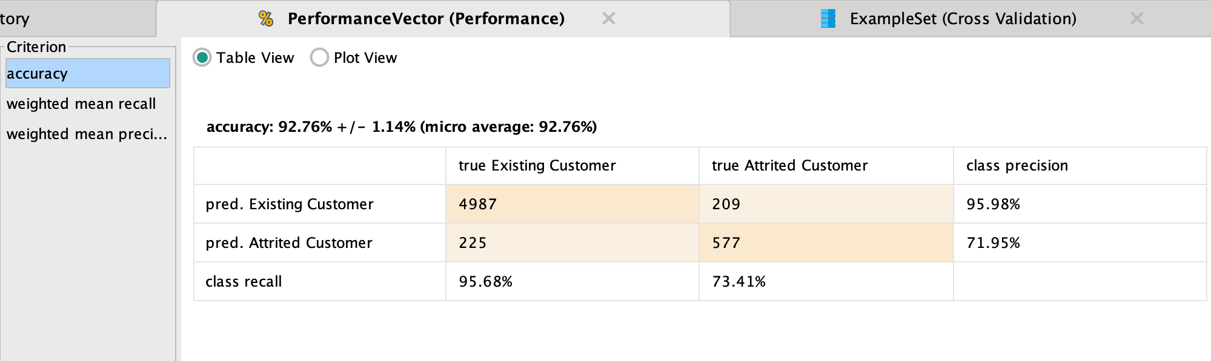
Accuracy, Precision and Recall for Cross Validation:
Saloni Bhaiya

Slide 13
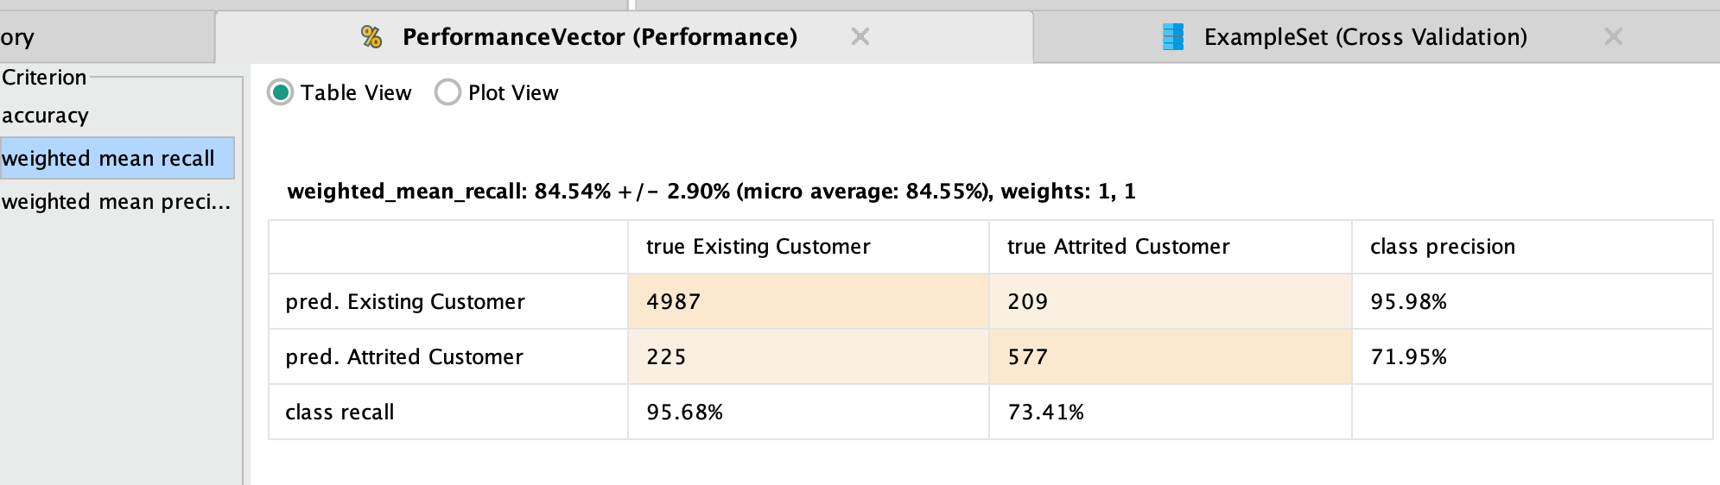
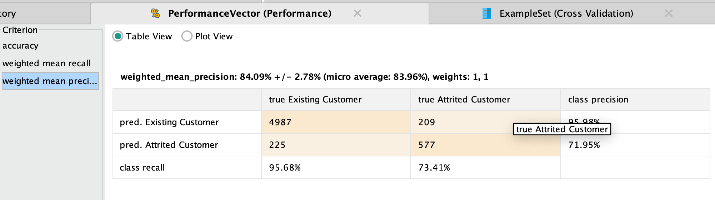
Saloni Bhaiya

Slide 14

Decision Tree
Sejal Arora

Slide 15
Model 2 - Decision Tree
Decision Tree is a Supervised learning technique that can be used for both classification and Regression problems.
It has a hierarchical, tree structure, which consists of a root node, branches, internal nodes and leaf nodes.
Decision trees are upside down which means the root is at the top and then this root is split into various several nodes.
The algorithm works by recursively splitting the data into subsets based on the most significant feature at each node of the tree.
Sejal Arora

Slide 16
Selected Attributes
Avg Utilization Ratio
Credit limit
Customer Age
Income category
Months on book
Total Relationship Count
Total Revolving Bal
Total Transaction Amt
Total Transaction Count
Attrition Flag
Sejal Arora

Slide 17
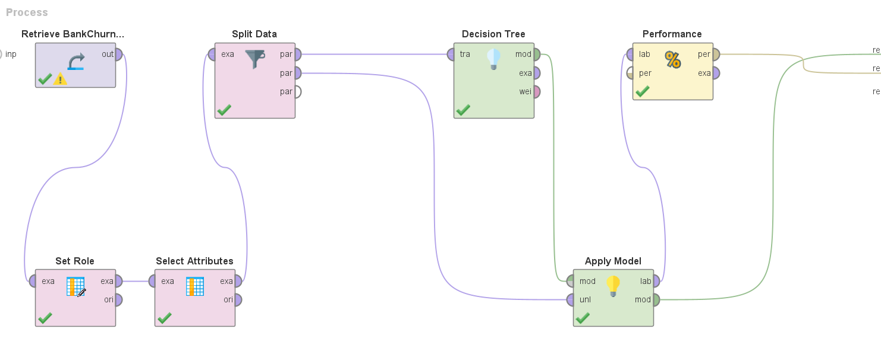
Model using Split Data Operator
Sejal Arora

Slide 18
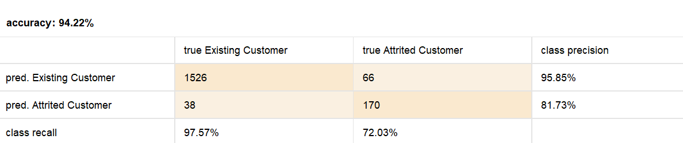
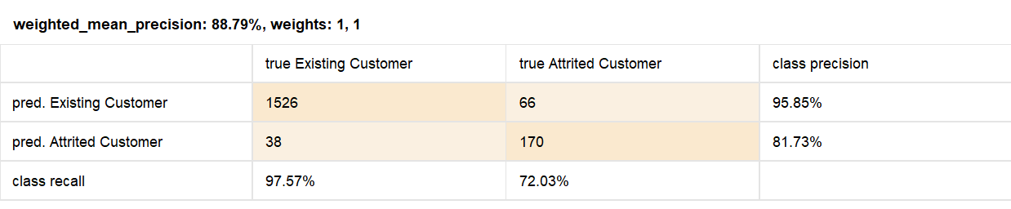
Results
Accuracy: 94.22% ,Precision: 88.79%, Recall:84.80%
Sejal Arora

Slide 19
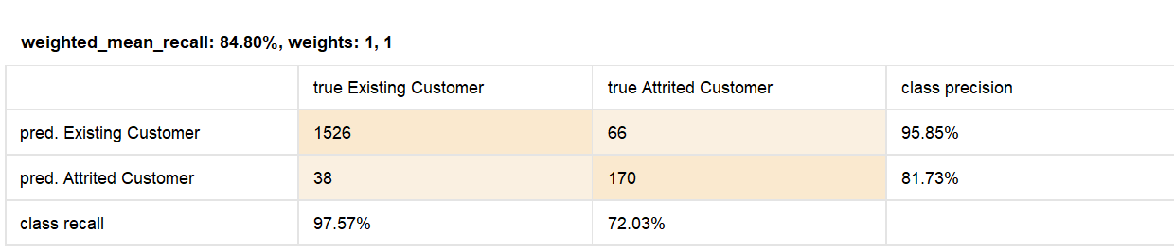
Results
Sejal Arora

Slide 20
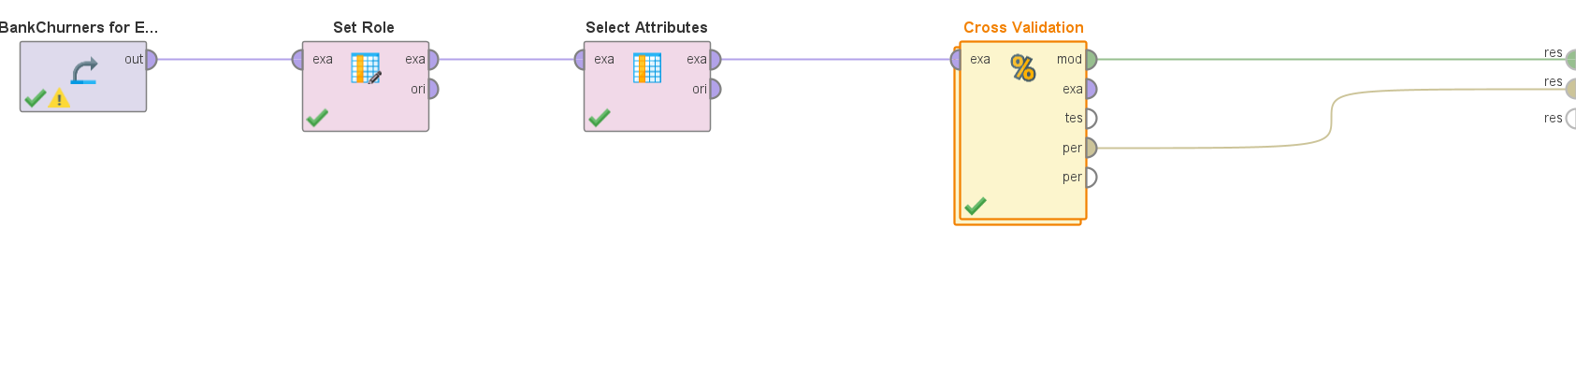
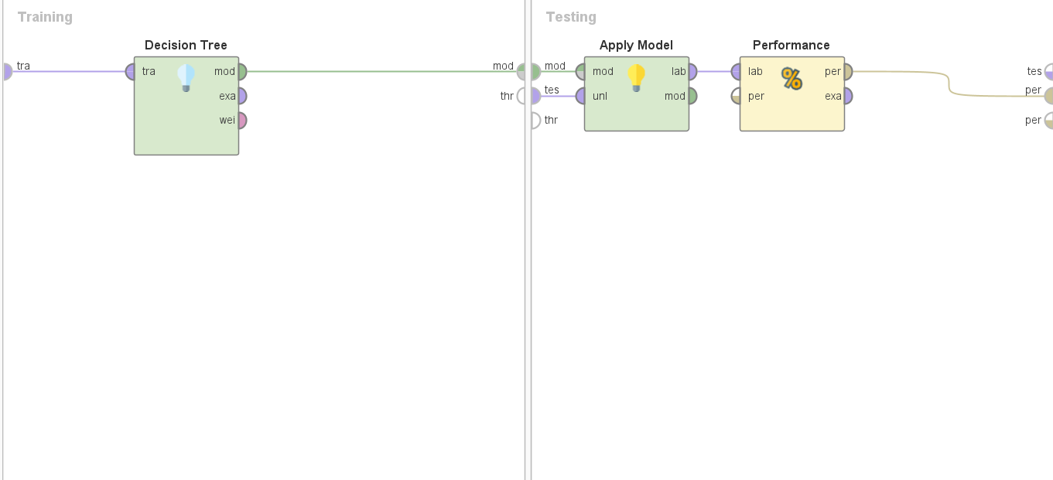
Model using Cross Validation
Sejal Arora

Slide 21
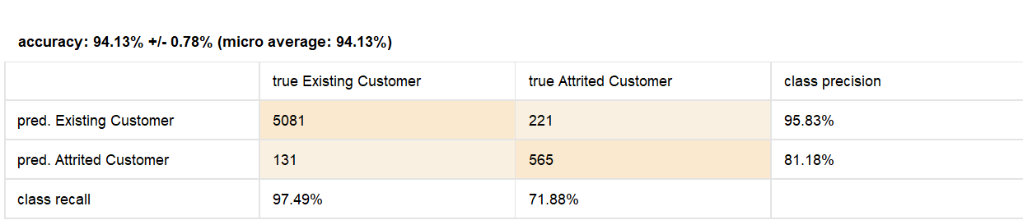
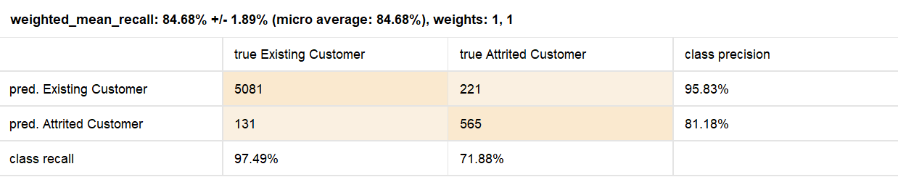
Results
Accuracy: 94.13% ,Precision: 88.66%, Recall:84.68%
Sejal Arora

Slide 22
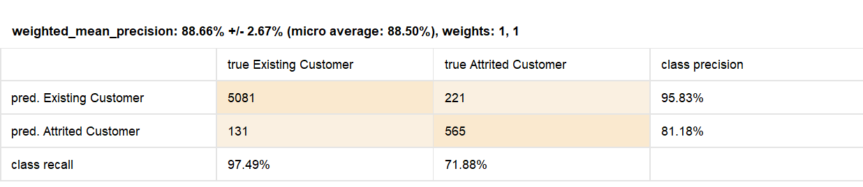
Results
Sejal Arora

Slide 23

Naïve Bayes
Monisha Vellore Dayananda

Slide 24
Naïve Bayes
It calculates the probability of a class given a set of features using Bayes' theorem.
Naive Bayes is simple and efficient and can handle large datasets.
It is often used in natural language processing, spam filtering, and sentiment analysis.
The choice of classifier depends on the type of data being used.
Naive Bayes is not suitable for tasks where the independence assumption does not hold, or when there are missing values in the data.
Monisha Vellore Dayananda

Slide 25
Naïve Bayes Types
Gaussian Naïve Bayes:Assumes independent and normally distributed features.
Categorical Naïve Bayes : Assumes features are categorical and calculates class probability using category frequency.
Multinomial Naïve Bayes: Assumes that the features are independent given the class.
Complement Naïve Bayes:It uses the opposite of each class to fix class mismatch in text classification.
Bernoulli Naïve Bayes: It models the presence or lack of boolean features in text classification.
Monisha Vellore Dayananda

Slide 26
Feature Selection
SelectKBest is a popular feature selection algorithm used in machine learning.
It selects the top K features from a dataset based on their importance scores.
Importance scores are calculated using statistical tests such as chi-squared, mutual information, or f-test.
Feature selection can improve model performance by reducing overfitting and reducing the amount of irrelevant information.
The value of K can be adjusted to balance model performance and computational complexity.
Monisha Vellore Dayananda

Slide 27
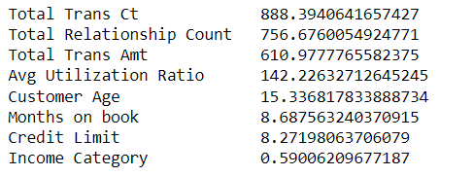
Feature Selection
Monisha Vellore Dayananda

Slide 28
Train Test Split
Train-test split is a technique used to evaluate the performance of a machine learning model.
It involves splitting a dataset into two separate subsets: a training set and a testing set.
The training set is used to train the machine learning model, while the testing set is used to evaluate its performance.
The ratio of the split depends on the size of the dataset and the specific task being performed, but a common split is 80% for training and 20% for testing.
Train-test split is important to use because it helps to prevent overfitting, which occurs when a model performs well on the training data but poorly on the testing data.
For this experiment I have chosen the split to be 80% training data and 20% test data
Monisha Vellore Dayananda

Slide 29
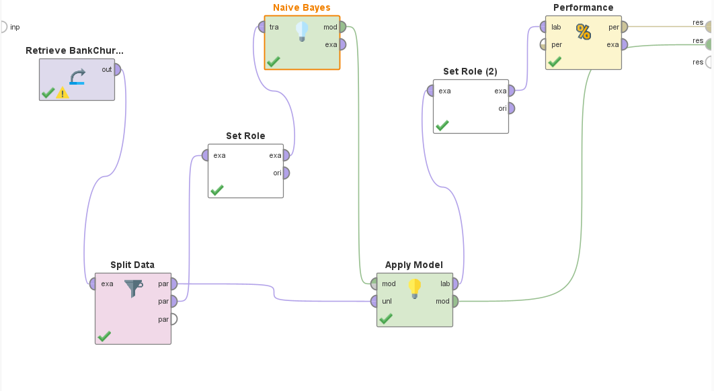
Naïve Bayes
Monisha Vellore Dayananda

Slide 30
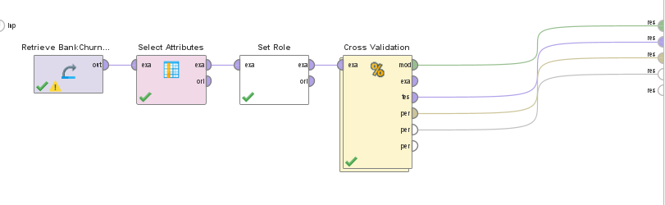
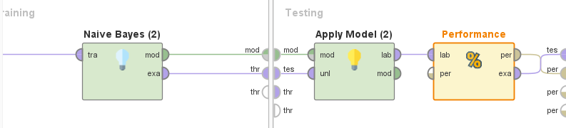
Naïve Bayes Cross Validation
Monisha Vellore Dayananda

Slide 31
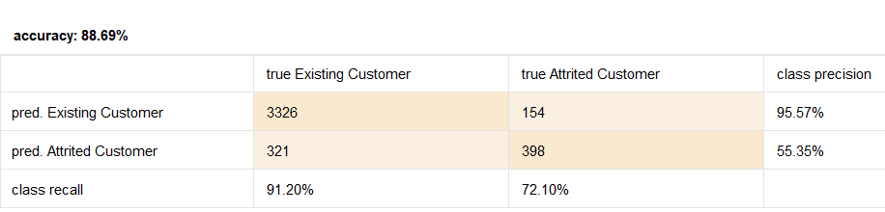
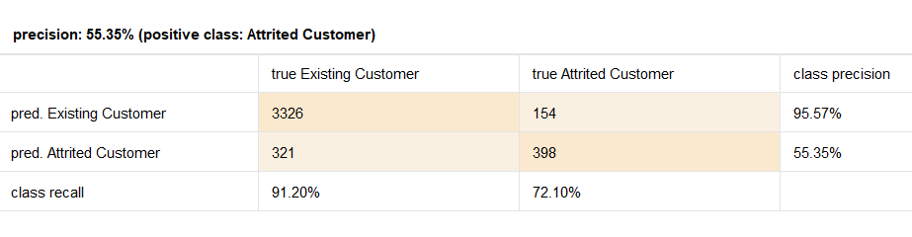
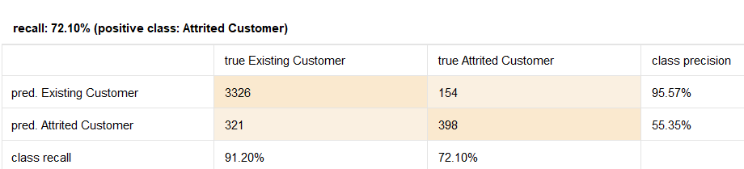
Naïve Bayes Cross Validation Results
Accuracy - 88.69%
Precision - 55.35%
Recall - 72.10%
Monisha Vellore Dayananda

Slide 32
Naïve Bayes Direct Model Scores - Python
Gaussian Naïve Bayes
Accuracy – 86.833%
Precision – 50.85%
Recall – 74.07%
Bernoulli Naïve Bayes
Accuracy – 86.5%
Precision – 50%
Recall – 0.62%
Multinomial Naïve Bayes
Accuracy – 63.17%
Precision – 22.22%
Recall – 69.13%
Complement Naïve Bayes
Accuracy – 62.83%
Precision – 22.04%
Recall – 69.14%
Categorical Naïve Bayes
Accuracy - 91.58%
Precision – 76.99%
Recall – 53.70%
Monisha Vellore Dayananda

Slide 33

Random Forest
Monisha Vellore Dayananda

Slide 34
Random Forest
It is an ensemble learning method that combines multiple decision trees to make predictions.
Each decision tree in the forest is trained on a randomly selected subset of the training data and a randomly selected subset of features.
Random Forest reduces the risk of overfitting by aggregating the predictions of multiple trees.
It can handle large datasets with high dimensionality and is relatively easy to tune.
Random Forest is often used in applications such as image classification, text analysis, and financial forecasting.
Monisha Vellore Dayananda

Slide 35
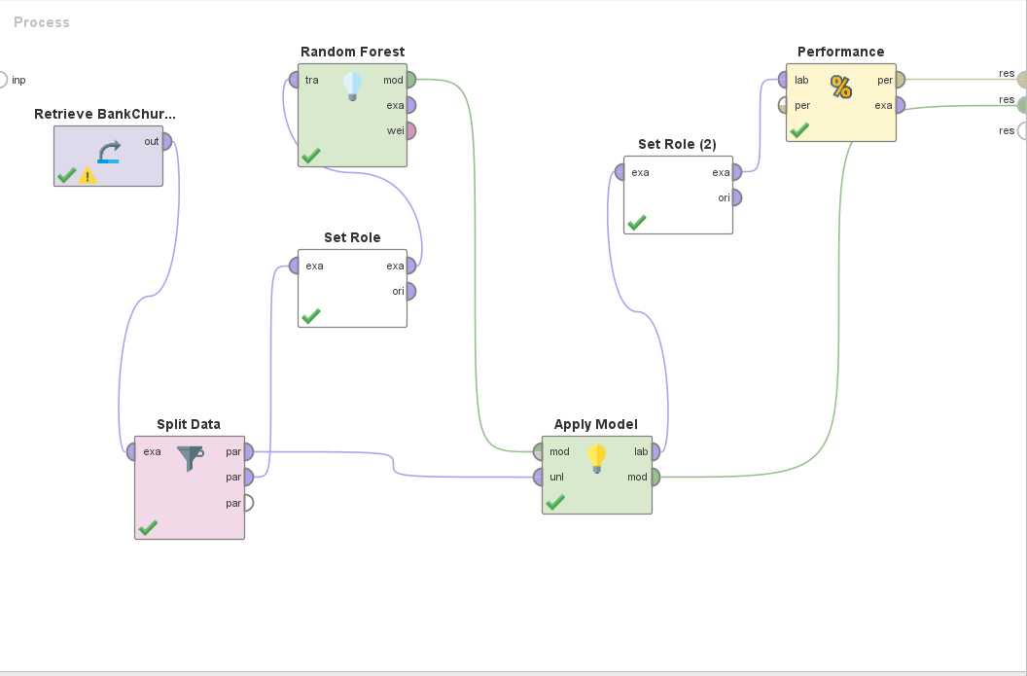
Random Forest
Monisha Vellore Dayananda

Slide 36
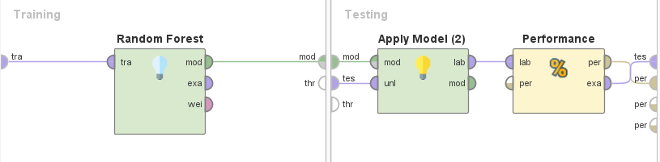
Random Forest Cross Validation
Monisha Vellore Dayananda

Slide 37
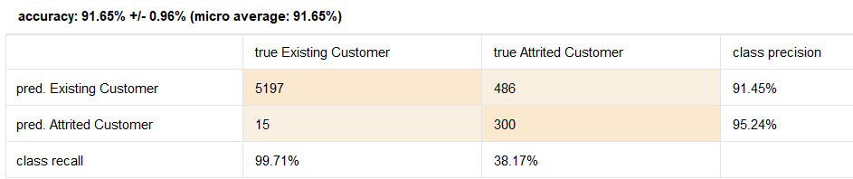
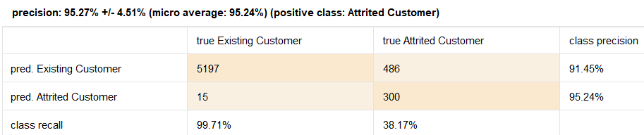
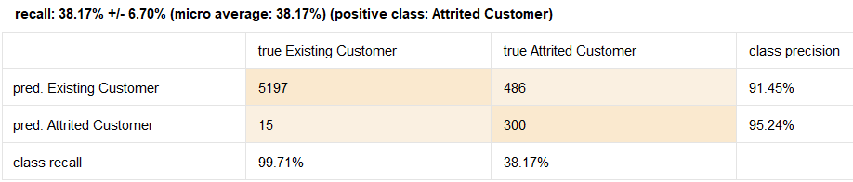
Random Forest Cross Validation Results
Accuracy - 91.65%
Precision - 95.27%
Recall - 38.17%
Monisha Vellore Dayananda

Slide 38

Cross Validation

Slide 39
Cross Validation – Grid Search
GridSearchCV is a technique used to find the best hyperparameters for a machine learning model.
It involves exhaustively searching over all possible hyperparameter combinations and evaluating their performance.
GridSearchCV can be computationally expensive, especially for high-dimensional hyperparameter spaces.
It is often used in conjunction with cross-validation to estimate the model's generalization performance.
GridSearchCV is supported by popular machine learning libraries such as scikit-learn.
It is a powerful tool for optimizing the performance of a model, but can be time-consuming and may not always find the optimal hyperparameters.
Monisha Vellore Dayananda

Slide 40
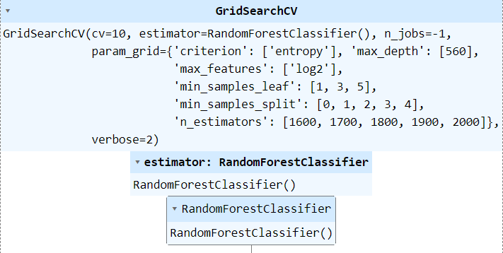
Cross Validation – Grid Search
Monisha Vellore Dayananda

Slide 41
Cross Validation – Randomized Search
Randomized Search CV is a technique used to find the best hyperparameters for a machine learning model.
It is a variation of grid search, which exhaustively searches over all possible hyperparameter combinations.
Randomized Search CV instead randomly samples a subset of the hyperparameters and evaluates their performance.
This process is repeated a specified number of times, with different random samples each time.
Randomized Search CV can be more efficient than grid search because it reduces the number of hyperparameter combinations to evaluate, especially for high-dimensional hyperparameter spaces.
It is often used in conjunction with cross-validation to estimate the model's generalization performance.
Monisha Vellore Dayananda

Slide 42
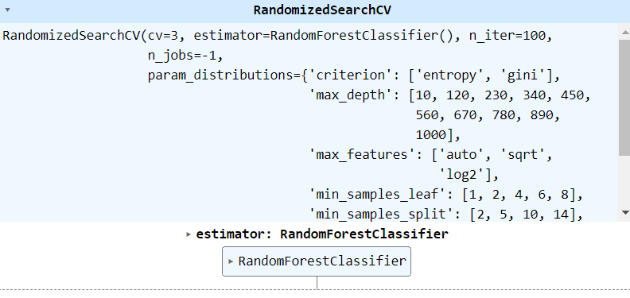
Cross Validation – Randomized Search
Monisha Vellore Dayananda

Slide 43
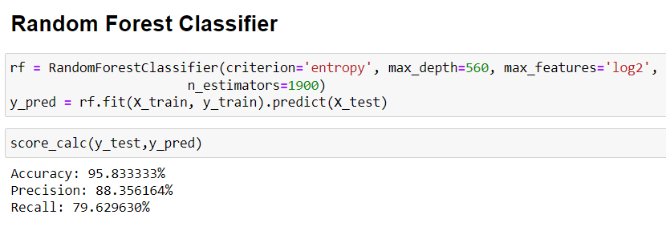
Random Forest Cross Validation Score - Python
Monisha Vellore Dayananda

Slide 44

Logistic Regression

Slide 45
Model 4 - Logistic Regression
For binary classification
Describes the link between the independent factors and the likelihood of churn to classify a customer’s churn probability
Selected Variables:
Avg Utilization Ratio
Marital Status
Credit Limit
Customer Age
Education Level
Gender
Total Ct Change Q4 Q1
Total Relationship Ct
Total Revolving Balance
Total Transaction Amt
Total Transaction Ct
Jolie Breitbach

Slide 46
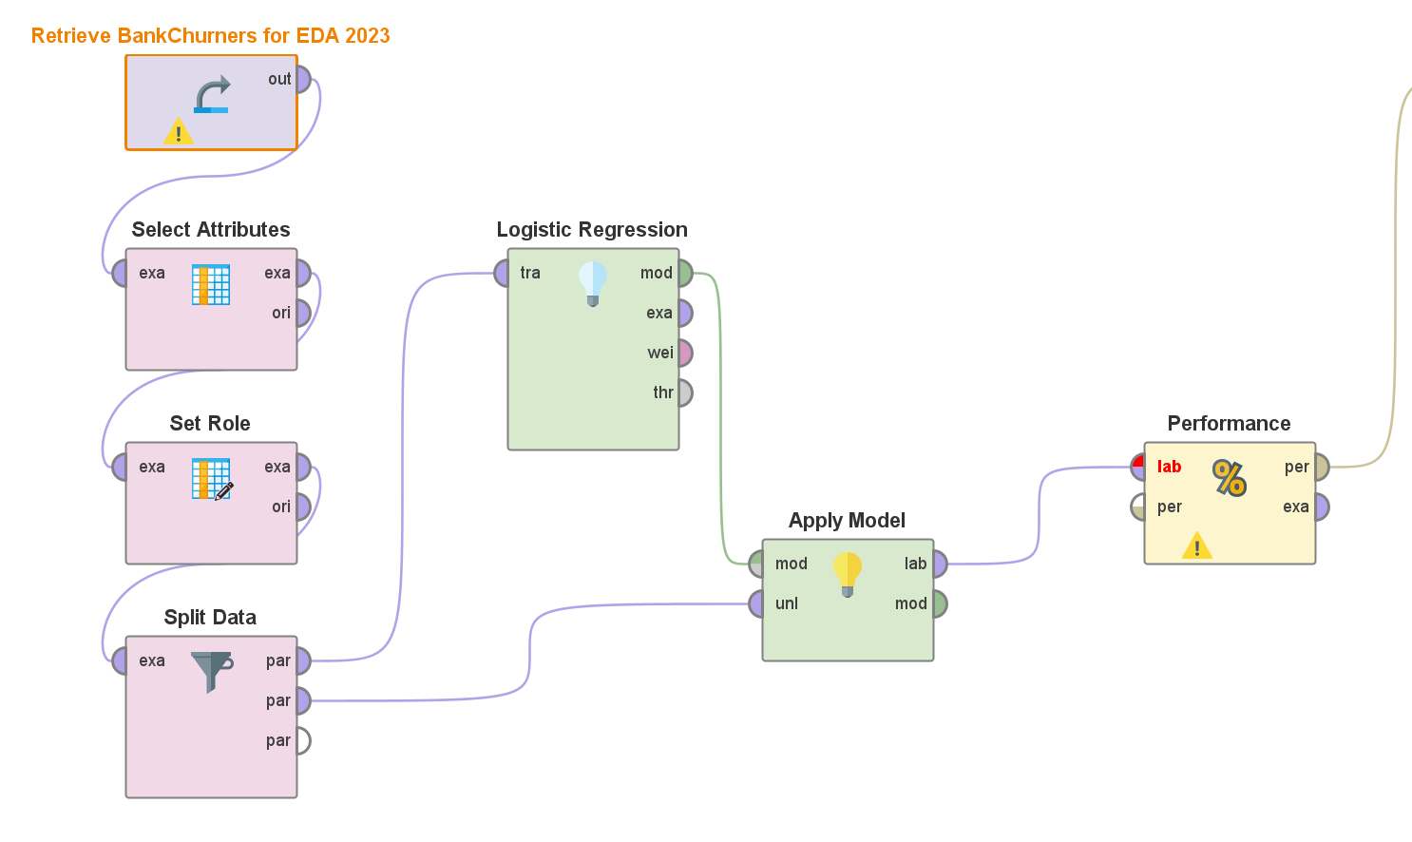
Splitting Data in 0.7/0.3 Ratio
Jolie Breitbach

Slide 47
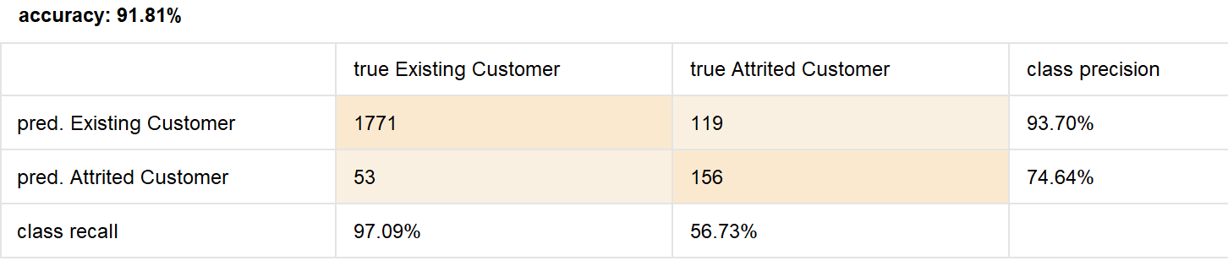
Results (0.7/0.3 Split)
Jolie Breitbach

Slide 48
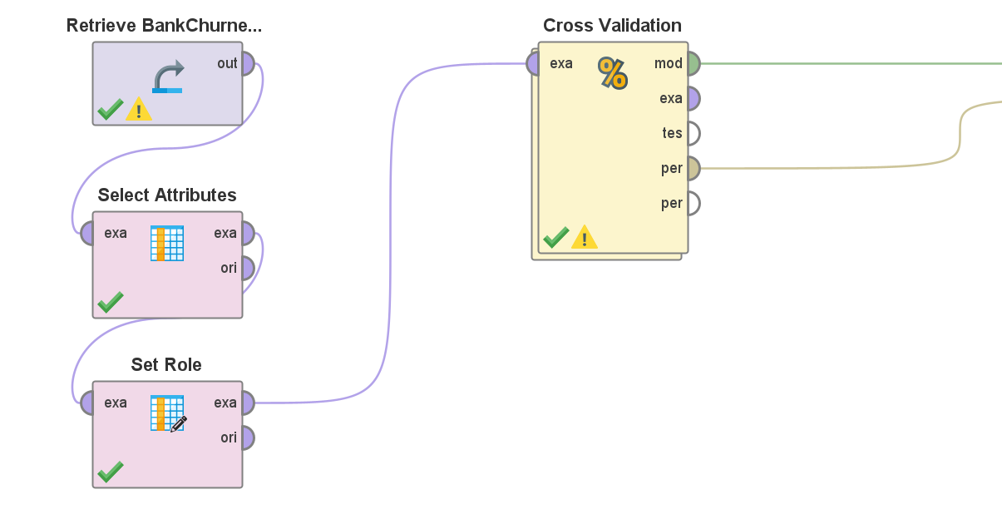
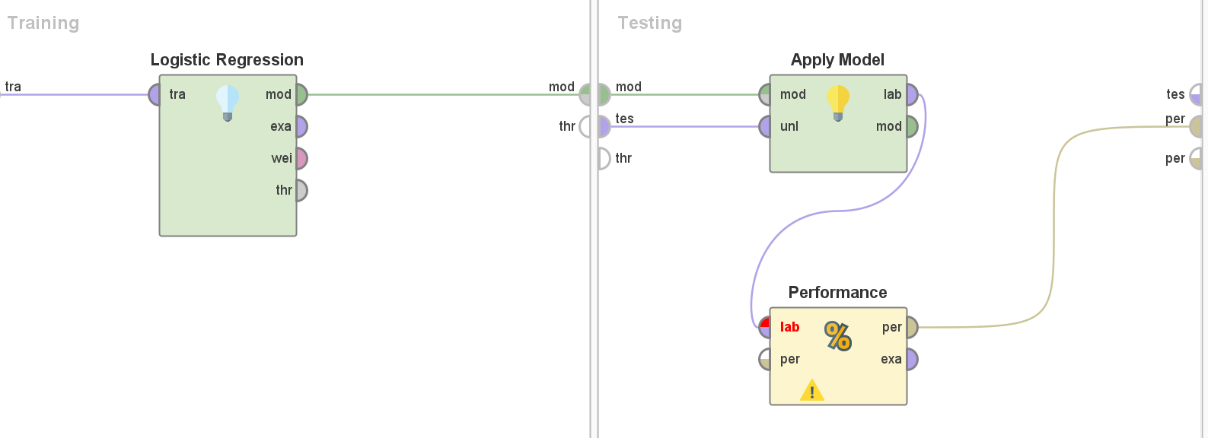
Using Cross Validation
Jolie Breitbach

Slide 49
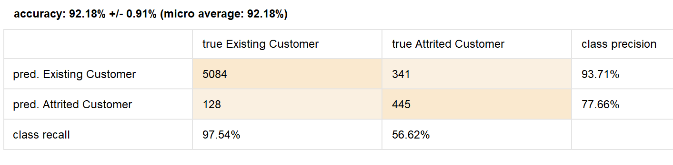
Results (Cross Validation)
Jolie Breitbach

Slide 50
Cross Validation Conclusion
Model | Accuracy | Precision | Recall
Deep Learning | 92.76 | 84.09 | 84.54
Decision Tree | 94.13 | 88.66 | 84.68
Random Forest | 95.84 | 88.36 | 79.63
Logistics Regression | 92.18 | 77.78 | 56.63
Based on our testing and results achieved through Cross Validation, the model that performed better in terms of Accuracy, Precision and Recall was Decision Tree and Random Forest.

Slide 51
THANK YOU

